Slide 1
Capstone Project-2
Transport Demand Prediction
Team members KAMALUDDIN SHAIKH AMOL RASAM SHUBHAM JHA PRETESH

Slide 2

Content
● Problem Statement ● Data Summary
● Dependant Variable ● Ride Origination Towns ● Top 5 place of Origin ● Day wise travel trend ● Hourly travel trend
● Time taken and Distance trend ● Feature Engineering ● ML Models and Metrics
● Feature Importance ● Challenges ● Conclusion

Slide 3

Problem Statement
Exploring 14 different towns to the northwest of the Nairobi towards Lake Victoria and using the data provided by bus ticket sales from MobiTicket, predicting the number of tickets that would be sold for the buses that ends into Nairobi.
Build a model that predicts the number of seats that Mobiticket can expect to sell for each ride, i.e. for a specific route on a specific date and time.

Slide 4
Data Summary
Nairobi Transport Data is the dataset of tickets purchased from Mobiticket for the 14 routes from “up country” into Nairobi between 17 October 2017 and 20 April 2018.
ride_id: unique ID of a vehicle on a specific route on a specific day and time.
seat_number: seat assigned to ticket.
payment_method: method used by customer to purchase ticket from Mobiticket (cash or Mpesa).
payment_receipt: unique id number for ticket purchased from Mobiticket.

Slide 5

travel_date: date of ride departure. (MM/DD/YYYY).
travel_time: scheduled departure time of ride. Rides generally depart on time. (hh:mm).
travel_from: town from which ride originated.
travel_to: destination of ride. All rides are to Nairobi.
car_type: vehicle type (shuttle or bus).
max_capacity: number of seats.

Slide 6
Dependant Variable
In our problem statement we didn’t have Dependant Variable. There are many ways to find our Dependant variable. But we used ride_id which is unique ID of a vehicle on a specific route on a specific day and time and seat_number which is seat assigned to ticket to find our Dependant variable.
By using Groupby method on ride_id and seat_number we got our Dependant Variable.

Slide 7
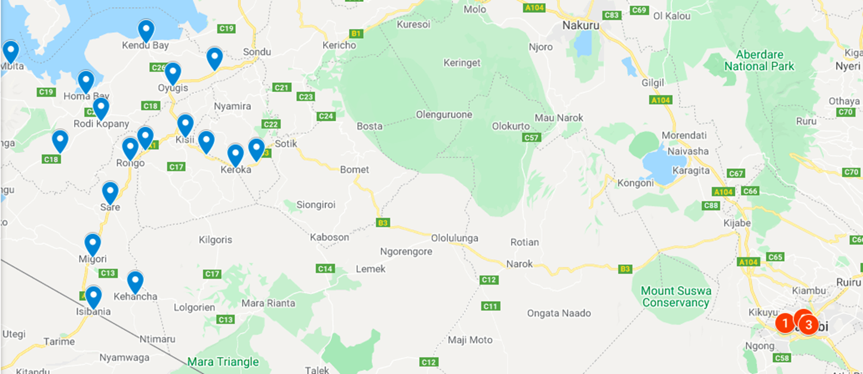
Map

Slide 8
EDA
Ride Origination Towns.
Top 5 places where most people are coming from.
Scatter plot of no_of_tickets from origination towns.
Day wise trend of no of tickets.
Hourly trend of no of tickets.
Time taken and Distance relation with no of tickets.

Slide 9
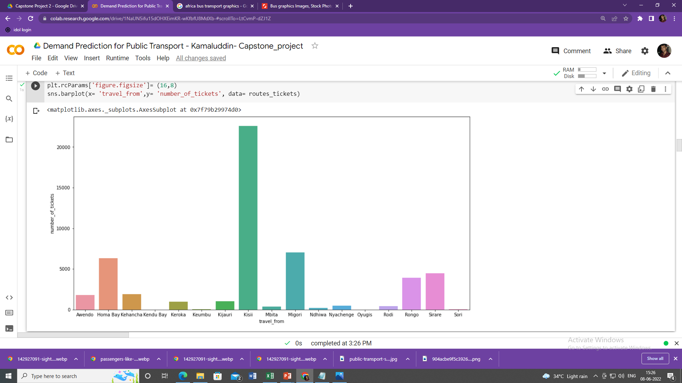
Ride Origin Towns
Kisii is the top place from where the most number of rides originate.

Slide 10
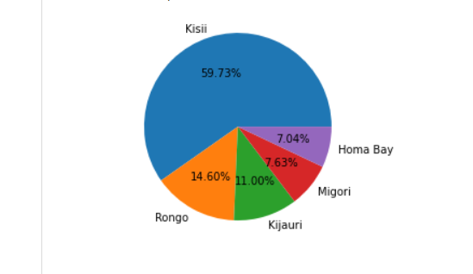
Top 5 places of Origin.
Most people are travelling from Kisii 59.73%, followed by Rango- 14.60%, kijauri-11%, Migori-7.63%, Homa Bay-7.04% etc.

Slide 11
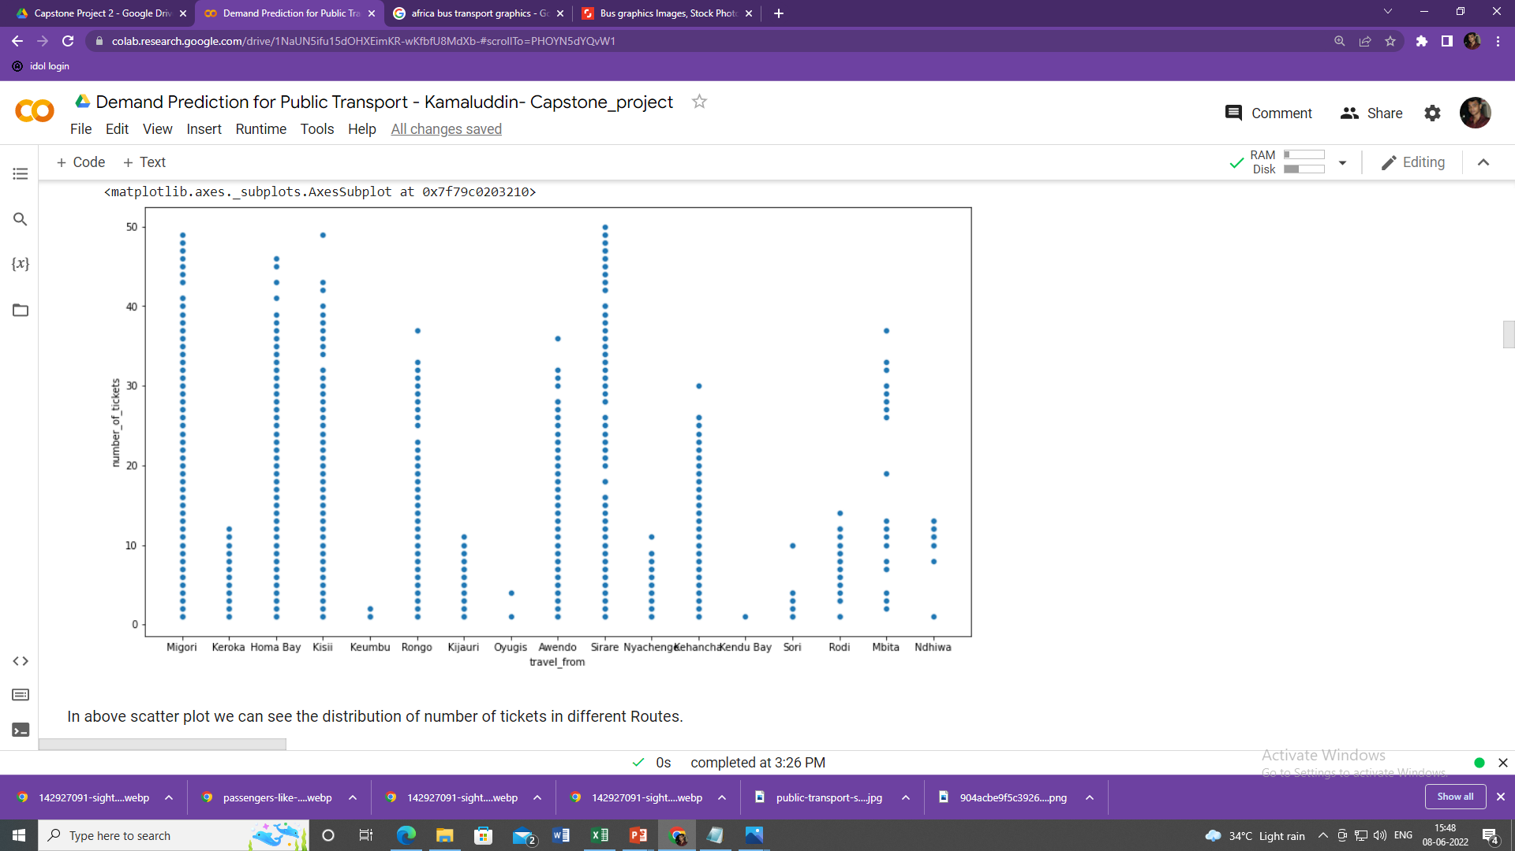
Scatter plot
Scatter plot of travel_from by number of tickets.

Slide 12
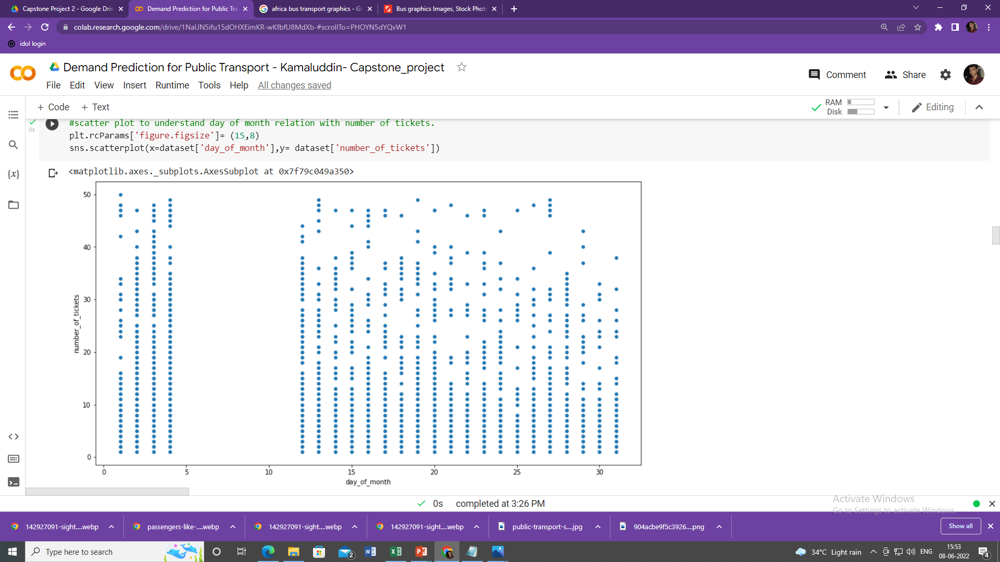
Day wise Travel Trend
There are no rides between 5th to 10th of every month, but this might be because of missing data or some public Holiday.

Slide 13
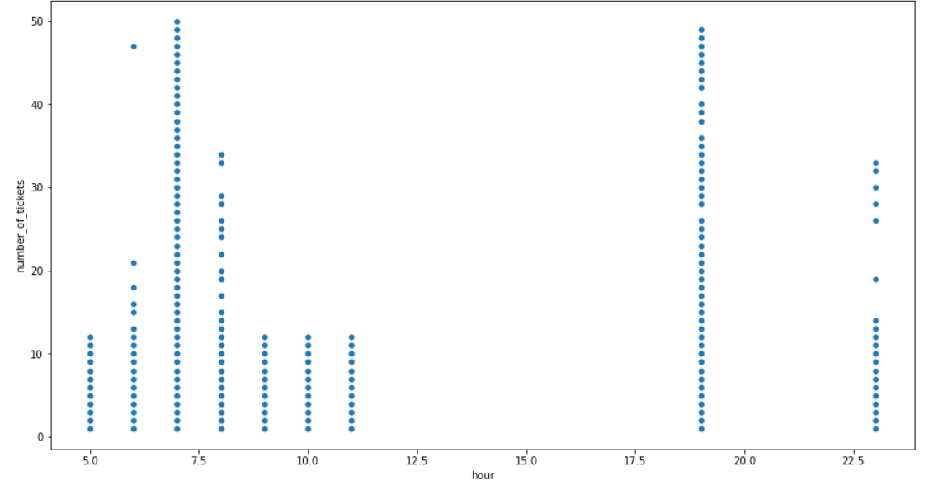
Hourly Travel Trend
Most of the tickets were sold at 7 AM and 8 PM. And that seems true because in the morning most of the people go to the work and office.
From the above we can say that there is not ride between 12pm to 5.30PM.

Slide 14
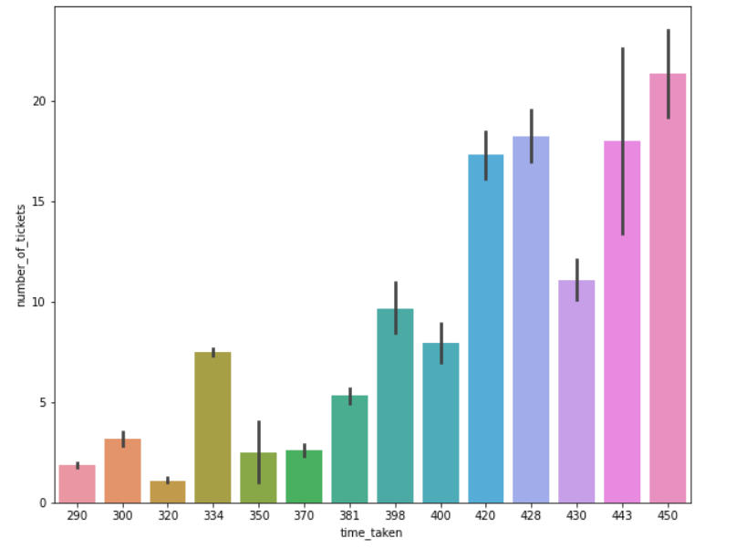
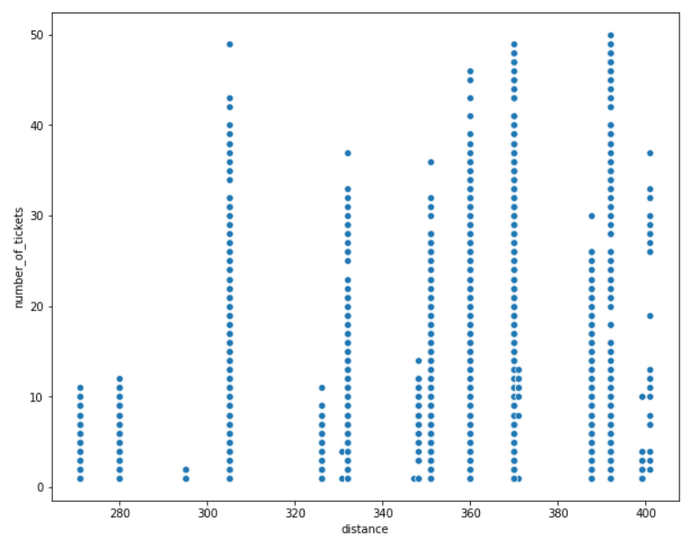
Time taken and Distance Trend
Time taken to reach Destination have positive relation with number of tickets. distance also have some what positive relation with no of tickets.
No of ticket sold is increasing with increase in time taken and distance.

Slide 15
Feature Engineering
Using domain knowledge to extract features from raw data, by which the performance of the model can be improved.
Number_of_tickets
Speed
Distance
Time_taken
Hour
Minute
Month
Day_of_week
Day_of_month
Is_weekend

Slide 16
ML Models and Metrics
Model Name | Train Accuracy | Test Accuracy | r2_score | Adjusted r2_score | MSE | RMSE | MAE | MAPE
Linear Regression | 0.366001 | 0.404588 | 0.404588 | 0.396211 | 46.063907 | 6.787040 | 4.643707 | 151.217350
Lasso Regression | 0.339320 | 0.344299 | 0.344299 | 0.335073 | 49.506884 | 7.036113 | 5.006458 | 181.637236
Ridge Regression | 0.374090 | 0.384397 | 0.384397 | 0.376073 | 46.479378 | 6.817579 | 4.739805 | 164.651974
Decision Tree | 0.587940 | 0.555827 | 0.555827 | 0.549334 | 33.536021 | 5.791029 | 3.974281 | 138.058099
Random Forest | 0.649787 | 0.665061 | 0.665061 | 0.659980 | 25.288646 | 5.028782 | 3.381311 | 115.978124
Xgboost | 0.792211 | 0.806540 | 0.806540 | 0.803605 | 14.606686 | 3.821869 | 2.579984 | 84.516617

Slide 17
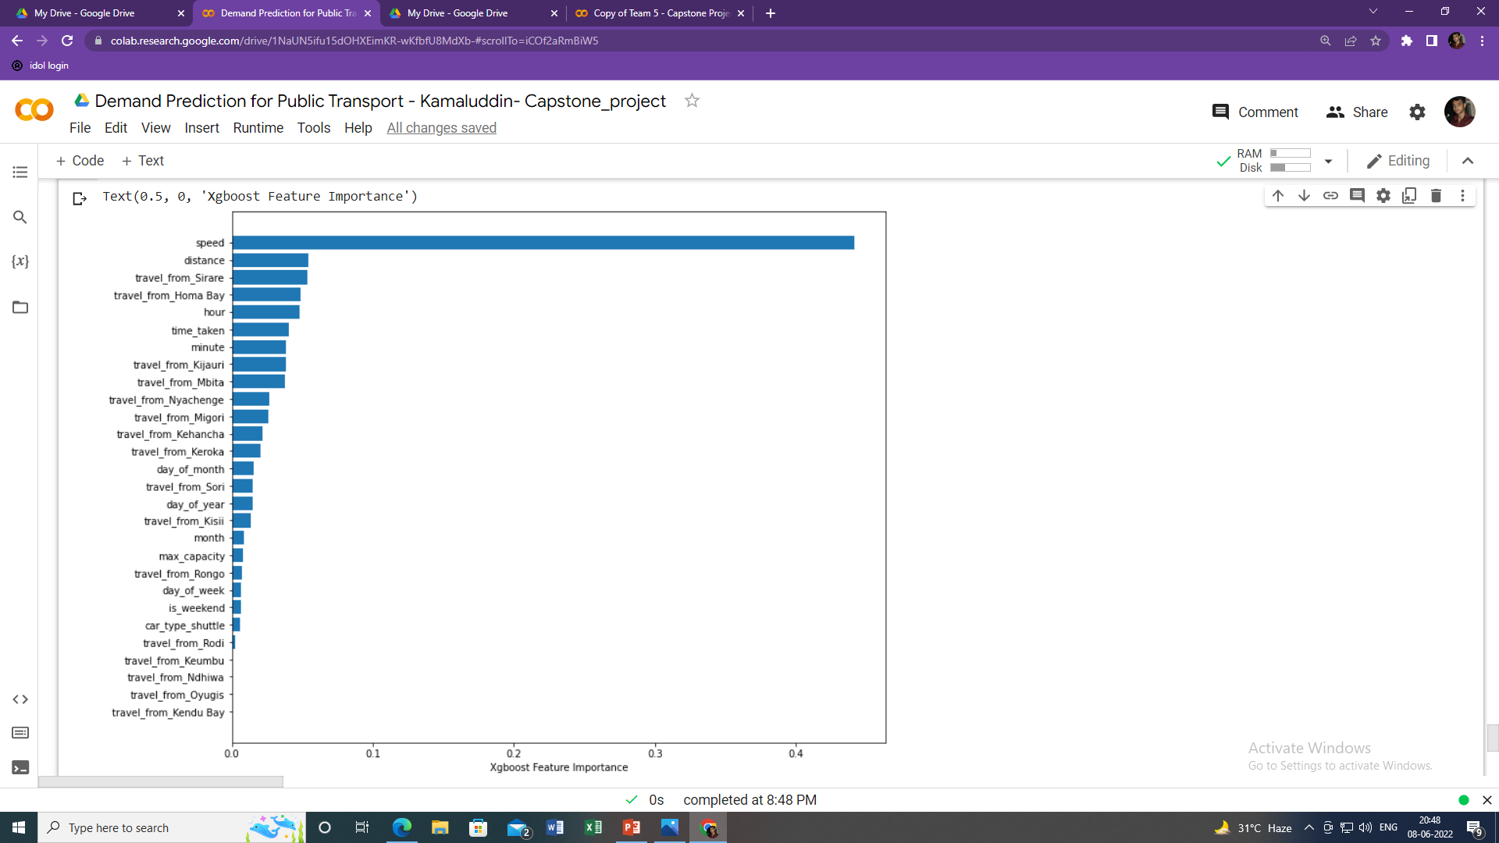
Feature Importance

Slide 18
Challenges
Finding the Dependant Variable
Feature engineering
Model Training and performance improvement
Tuning Hyperparameter.

Slide 19
Conclusion
As we have implemented six different models to predict the number of seats that Mobiticket can expect to sell for each ride. Linear Regression, Regularized linear regression (Ridge and Lasso), Decision Tree, Random Forest Regressor and Xgboost Regressor. Xgboost regression model performed the best among them.
Our Model will help Mobiticket and Bus operators to anticipate the number of tickets they can expect to sell for each ride.

Slide 20
Thank You

